Slide 1
Day 1 Workflow & data analysis

Slide 2



Why workflow for data analysis?
What is the mean age in Kiribati?
25.3 years
24.3 years
23.3 years

Slide 3
Why do they differ?
Who is correct?

Slide 4
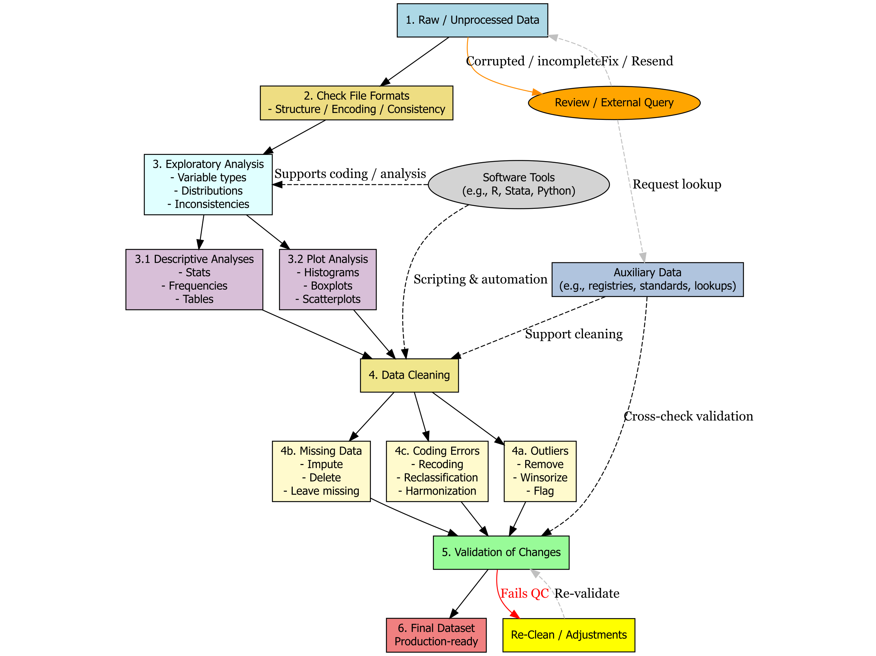
How to resolve this problem in data analysis? Workflow

Slide 8
Principles for a good workflow
Data management: The best practices for storing in adequate formats, merging, joining, appending different datasets, and have clarity about types of variables and vectors.
Data cleaning: Identifying and correcting inconsistencies or errors based on an explicit guideline of what is inconsistent, and an error based on the context of the data. This often involves the formal detection of errors using statistical tool and semiautomated checks (regular expressions).
Data validation: Is the process of examining, transforming and drawing conclusions about the quality of the data and, if necessary, about the changes made in previous stages.

Slide 9
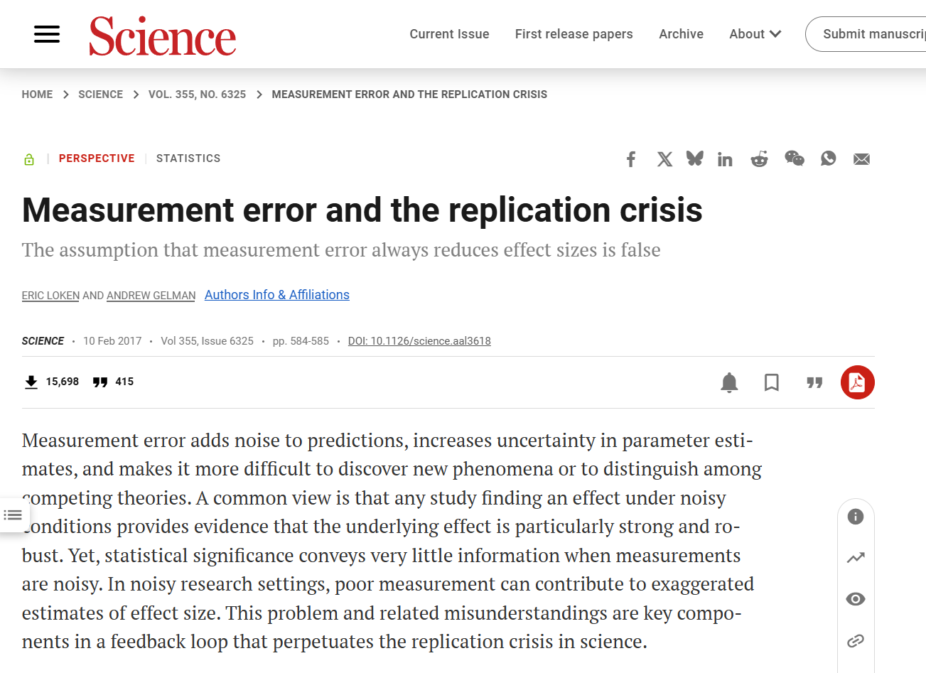
Why workflow and good practices?
Replication of a result is desirable:
Builds credibility around a finding
We can claim that we discovered something with confidence
There are 20% people unvaccinated
There are 15 children for every teacher
The disposable income has fallen by 2 %

Slide 10
Why workflow and good practices?
In data analysis we want:
Identify fast where we failed
Trace back our mistakes
Allow others to help us to understand problems
Allow others to help us to resolve problems
Have a written memory of the decisions we took
Reproduce our results every time we are ask about them

Slide 11
Can you tell me if you can do these things all the time? (raise your hand)
Identify fast where you failed
Trace back all our mistakes
Allow others to help to understand problems with your analysis
Allow others to help to resolve problems with your analysis
Have a written memory of the decisions we took
Reproduce your results every time you are ask about them

Slide 12
Wouldn't be great if there is a written memory that does all the previous things for us?
Wouldn't be great to push a button and get all our results?

Slide 13
The role of software
Excel, Stata, SPSS and R atempt to automate these things.
But some are better than others.
R-software is more flexible and more powerful
See it as an investment. Things that take a day in Excel can take 5 minutes in R.

Slide 14
What is R?
Free and open-source programming language for statistical computing
Popular in academia, research, and industry
Supported by RStudio / Posit

Slide 15
Why R?
Great for data manipulation, analysis, visualization
Reproducible workflows (scripts, markdown, packages)
Strong community and extensive package ecosystem

Slide 16
Show a full example
How to create a full report from R and RMarkdown

